Slide 1
Chapter 13: Industrial-Organizational Psychology

Slide 2
WHAT IS INDUSTRIAL-ORGANIZATIONAL PSYCHOLOGY?
A branch of psychology that studies how human behavior and psychology effect work and how they are affected by work.
Industrial-Organizational psychologists work in:
Academia
Government
Consulting firms
Business

Slide 3
AREAS OF INDUSTRIAL-ORGANIZATIONAL
PSYCHOLOGY
Industrial Psychology
Studies job characteristics, applicant characteristics, and how to match them; also studies employee training and performance appraisal.
Focuses on hiring and maintaining employees.
Considers issues of legality regarding discrimination in hiring.
Organizational Psychology
Studies interactions between people working in organizations and effects of those interactions on productivity.
Interested in worker satisfaction, motivation, commitment, management and leadership styles, social norms and role expectations.
Considers harassment and workplace violence.

Slide 4
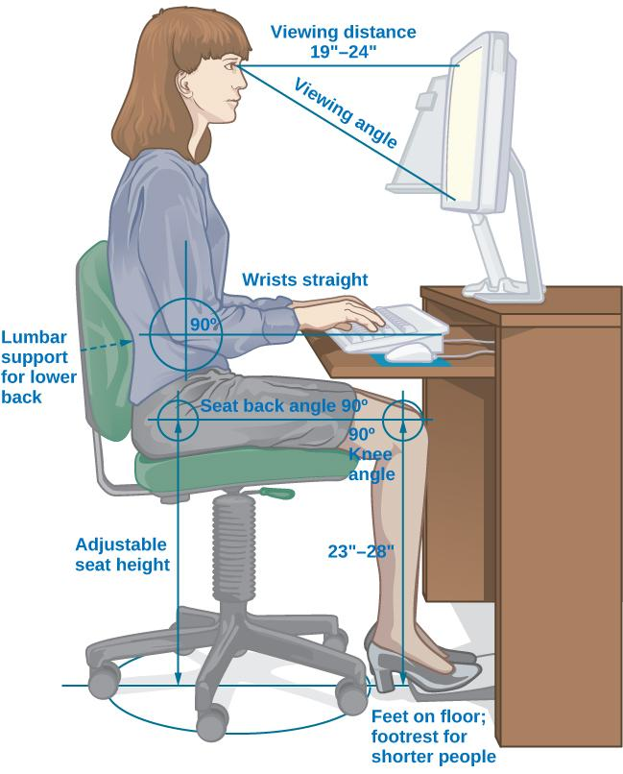
AREAS OF INDUSTRIAL-ORGANIZATIONAL
PSYCHOLOGY
Human Factors Psychology
Studies how workers interact with the tools of work and how to design those tools to optimize workers’ productivity, safety, and health.
Known as Ergonomics
Tools of work can include interaction with a machine, work station, information displays, and the local environment (e.g., lighting).

Slide 5
HISTORICAL DEVELOPMENT (1)
Early 20th Century
James Cattell, Hugo Munsterberg, Walter Dill Scott:
Students of Wilhelm Wundt.
Conducted research focusing on what is now called industrial psychology.
Cattell - founded the Psychological Corporation, a psychological consulting company.
Munsterberg – published Psychology and Industrial Efficiency (1913), which covered employee selection, employee training, and effective advertising.
Scott – one of the first psychologists to apply psychology to advertising, management, and personnel selection. Published the first books to describe the use of psychology in the business world.

Slide 6
HISTORICAL DEVELOPMENT (2)
WW1
Robert Yerkes:
Organized a group that developed methods for screening and selecting enlisted men.
Developed the Army Alpha/Beta tests to measure mental abilities.
Scott and Walter Bingham:
Organized a group with the goal to develop selection methods for officers.
Notes:
Alpha/Beta handouts

Slide 7
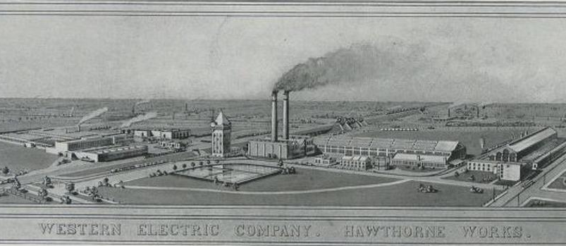
HISTORICAL DEVELOPMENT (3)
Elton Mayo
Conducted studies at Western Electric’s Hawthorne Work (1929-1932).
Explored interpersonal relations, motivation, and organizational dynamics.
Examined how human interaction factors enhanced or decreased productivity.
Origin of organizational psychology.
Researchers reported that any changes they made to variables resulted in increased productivity.

Slide 8
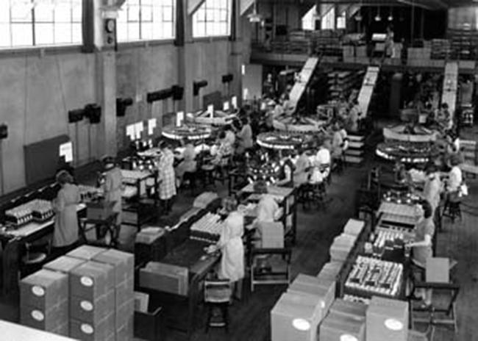
HAWTHORNE EFFECT
Years after Mayo’s study, researchers analyzed the results and noticed that employees performed better when researchers or supervisors observed and interacted with them.
Suggested that productivity increased because people’s performance changes when they are being observed.
Hawthorne Effect - The increase in performance of individuals who are noticed, watched, and paid attention to by researchers or supervisors.

Slide 9
HISTORICAL DEVELOPMENT (4)
Kurt Lewin (1930s)
Researched effects of leadership styles, team structure, and team dynamics.
Studied group interactions, cooperation, competition, and communication.
Coined the term group dynamics

Slide 10
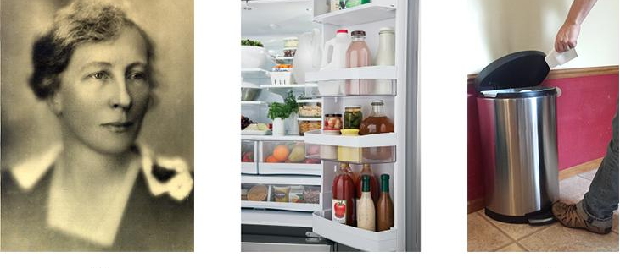
HISTORICAL DEVELOPMENT (5)
Lilian Gilbreth – The Mother of Modern Management
Strove to find ways to increase productivity.
Studied efficiency improvements that reduced the number of motions required to perform a task and were applicable in the workplace, home, and other areas.
Credited with the idea of putting shelves on the inside of refrigerator doors and foot-pedal-operated garbage cans.
Investigated employee fatigue and time management stress.
Found many employees were motivated by money and job satisfaction.

Slide 11
SELECTING EMPLOYEES
Job Advertising
Job analysis – accurately describing the task/job.
Task-oriented – lists in detail the tasks that will be performed for the job.
Worker-oriented – describes characteristics required of the worker to successfully perform the job (e.g., knowledge, skills, abilities).
O*Net – database of previously compiled job analyses for different jobs and occupations.
Candidate Analysis and Testing
Can involve testing, interviews, and work samples, or exercises.
Personality tests can be used to identify personality characteristics of the candidate and match those personality characteristics that would ensure good performance on the job.
Other tests can include IQ tests, integrity tests, and physical tests, such as drug tests or physical fitness tests.

Slide 12
The Typical Job Interview (1 of 2)
Do interviews promote sound hiring?
Research suggests interviewing has mixed effects
  Possibility of race and ethnic background biases, race may at times shape whether an applicant is interviewed in the first place.
  Bertrand & Mullainathan (2004)
  Cotton et al. (2007) “common vs unique names”

Slide 13

The Typical Job Interview (2 of 2)
Although interviews often result in the right selection of new employees, they sometimes lack predictive validity.
  Most job applicants use impression management tactics to present themselves in a positive light.

Slide 14
INTERVIEWS
Interviews can be influenced by social factors and body language such as the degree of similarity of the applicant to the interviewer and nonverbal behaviors (e.g., hand gestures, head nodding, and smiling).
Research found that lack of eye contact and smiling lead to lower applicant ratings.
Unstructured interview:
Different questions for different candidates.
Questions are usually unspecified beforehand.
Structured interview:
Same questions for every candidate.
Questions are prepared in advance.
Standardized rating system for each response.
More effective at predicting subsequent job performance of the job candidate.

Slide 15
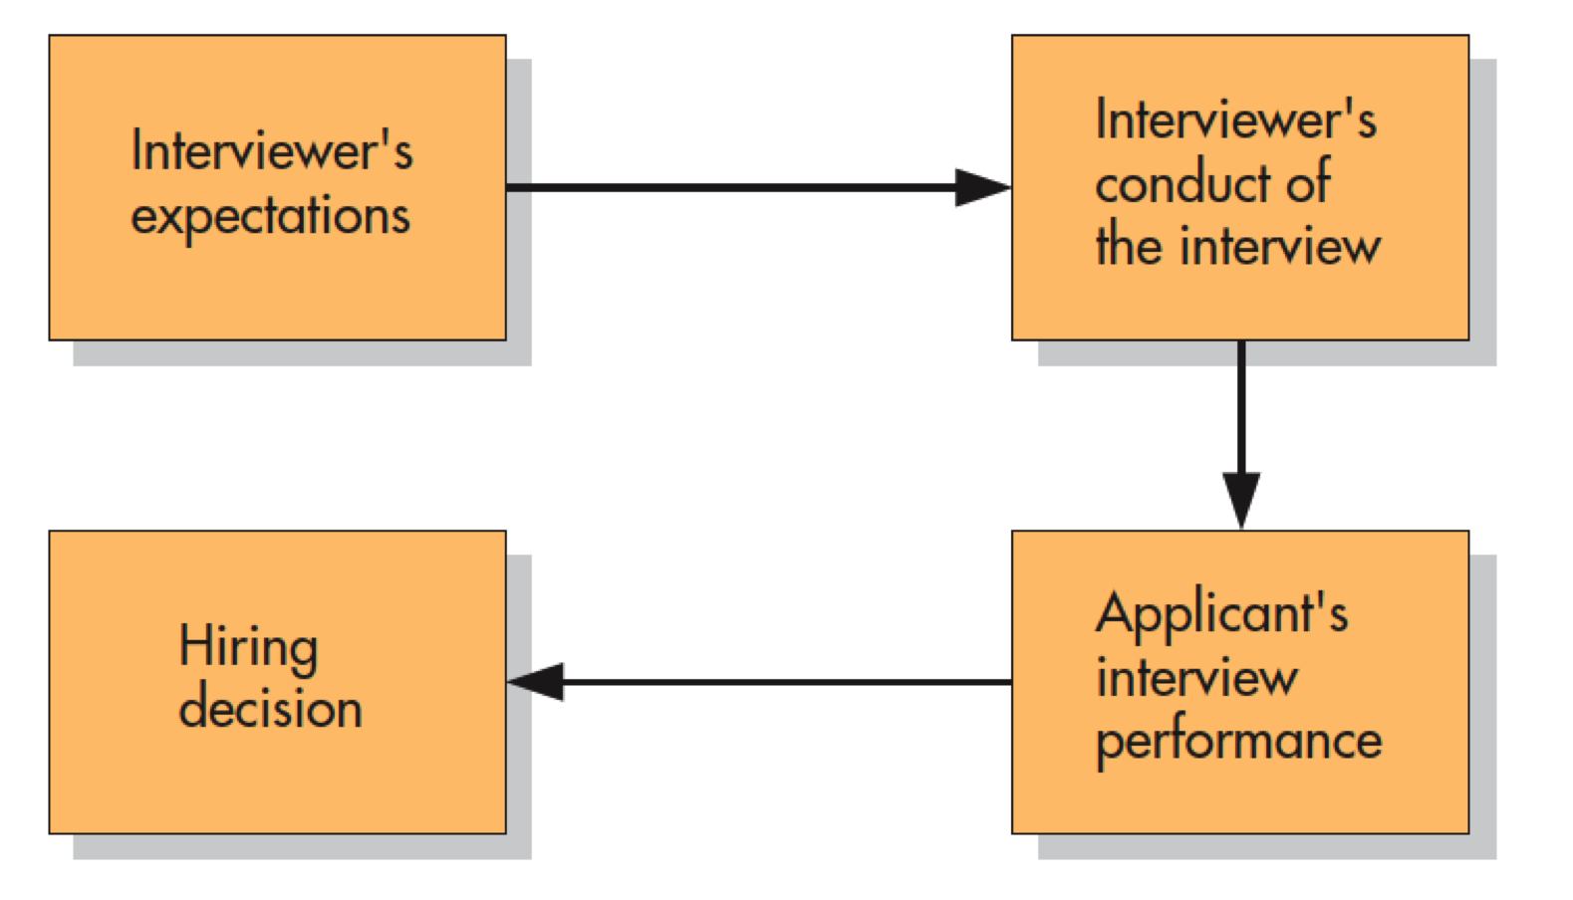
Job Interviews: A Self-Fulfilling Prophecy?
Notes:
Figure 13.1 Job Interviews: A Self-Fulfilling Prophecy? One study indicates that interviewers’ expectations influence the kinds of interviews conducted and applicants’ performance. The higher the expectations, the more the interviewer tries to impress rather than evaluate the applicant and make a favorable hiring decision. Without realizing it, employers may use job interviews to create a reality that supports their prior beliefs. Phillips and Dipboye, 1989

Slide 16
Cybervetting
Using the Internet to get informal, noninstitutional data about applicants that they did not choose to share
Many employers reported cybervetting good applicants after receiving their résumés.
  Seeking visual, textual, technological, and relational information
No research exists on the effects of cybervetting on the quality of hiring decisions.

Slide 17
“Scientific” Alternatives to Traditional Interviews
Standardized tests
  Intellectual and cognitive abilities
  Job-specific knowledge and skills
  “Street smarts” and common sense
Personality tests
Integrity tests

Slide 18
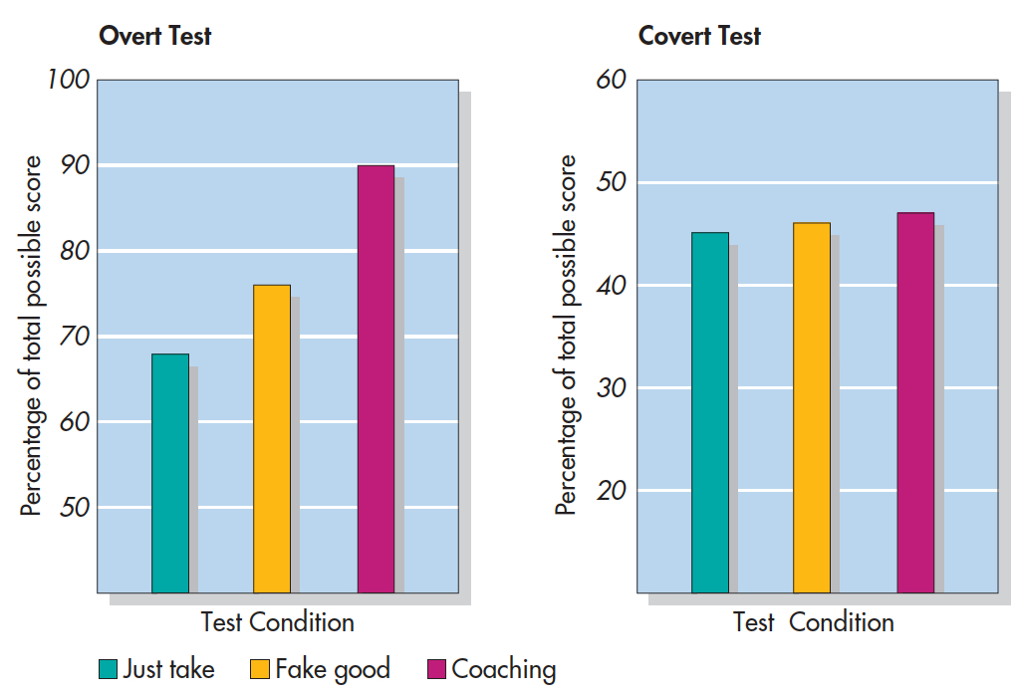
Can Integrity Tests Be Faked? (Alliger et al., 1996)
Notes:
Figure 13.2 Can Integrity Tests Be Faked? Alliger and others (1996) gave college students overt and covert integrity tests. Some just took the test, others were told to “fake good,” and others were coached. On the overt test, scores increased for subjects who faked good or were coached (left). On the covert test, scores were unaffected by these interventions (right). Alliger et al., 1996

Slide 19
Personnel Selection as a Two-Way Street
How do applicants feel about the hiring process?
  People see concrete, job-specific tests, and interview situations as the most fair.
  They dislike impersonal standardized tests of intelligence, personality, and honesty.

Slide 20
JOB TRAINING
Orientation:
Training usually begins with an orientation period during which a new employee learns about company policies, practices, and culture.
Educates the new employee about the organizational culture, the values, visions, hierarchies, norms and ways the company’s employees interact.
Mentoring:
Experienced employee guides the work of a new employee.
Mentors may be formally assigned or develop informally.
Research on mentoring:
Mentoring positively affected protégés compensation, and number of promotions compared with non-mentored employees.
Protégés were more satisfied with their careers and had greater job satisfaction.

Slide 21
EVALUATING EMPLOYEES
Industrial-organizational psychologists are often involved in designing performance-appraisal systems for organizations.
Aim to make evaluations as fair and positive as possible, and decrease subjectivity.
Performance appraisals – evaluation of an employee’s success or lack of success at performing the duties of the job.
Often used to motivate employees to improve performance and expand areas of competence.
360-degree Feedback Appraisal:
Supervisors, customers, direct reports, peers, and the employee himself rate an employee’s performance.
Provides different perspectives of employees job performance.
Often fail to accomplish their purpose because they are used incorrectly.

Slide 22
BIAS & PROTECTION IN HIRING
Selecting candidates based on group membership, when it does not directly affect potential job performance, is discriminatory.
Many laws exist to prevent hiring based on various group-membership criteria.
Pregnancy, religion, and age are some of the criteria on which hiring decisions cannot legally be made.
Did you know it is illegal for a potential employer to ask your age in an interview?

Slide 23
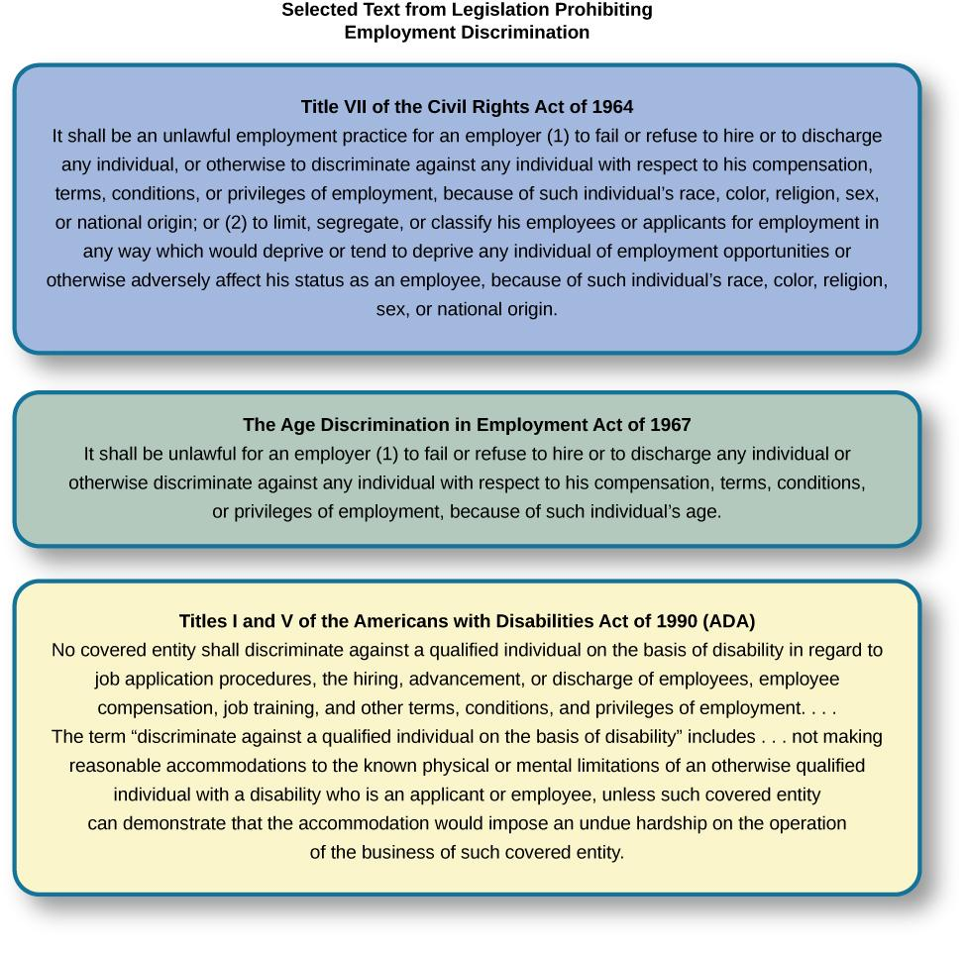
Notes:
Responsible for enforcing federal laws that make it illegal to discriminate against a job applicant or an employee because of the person’s race, color, religion, sex (including pregnancy), national origin, age (40 or older), disability, or genetic information.

Slide 24
THE U.S. EQUAL EMPLOYMENT
OPPORTUNITY (EEOC) (1)
Equal Pay Act – requires equal pay for men and women in the same workplace who are performing equal work.
Title VII of the Civil Rights Act (1964) – makes it illegal to treat individuals unfavorably because of their race or color of their skin.
Pregnancy Discrimination Act (1978) – prohibits job discrimination of a woman because she is pregnant as long as she can perform the work required.

Slide 25
The Gender Wage Gap
Equity in the workplace is important—and it may mean different things for men and women.
What factors contribute to the gender pay gap?
  Are women valued less?
  Or are women are less assertive at negotiating starting salaries?

Slide 26
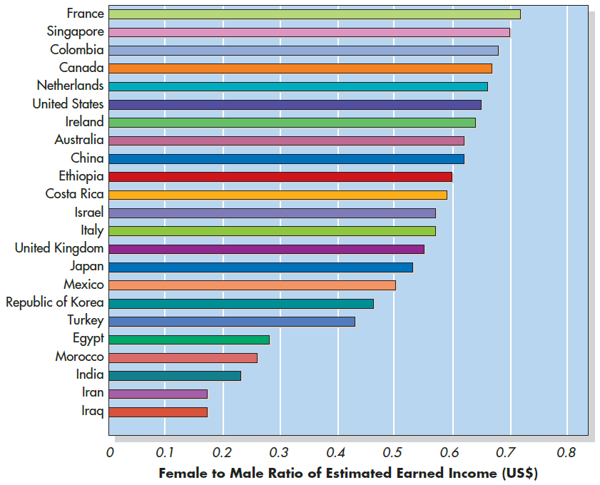
World Economic Forum (2018)
Notes:
Figure 5.7 Gender Ratio in Income in Selected Countries Around the World These international labor statistics show the female-to-male ratio of earned income in each of a variety of countries around the world. The smaller the bar, the less income women earn compared to men in the country. Source: World Economic Forum (2018)

Slide 27
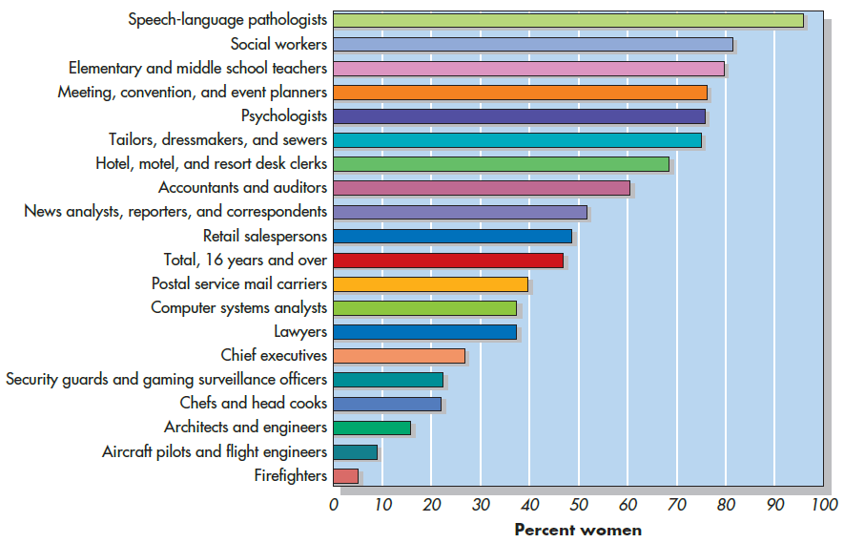
U.S. Bureau of Labor Statistics (2018)
Notes:
Figure 5.6 Percentage of Women in Specific Occupations in the United States, 2018

Slide 28
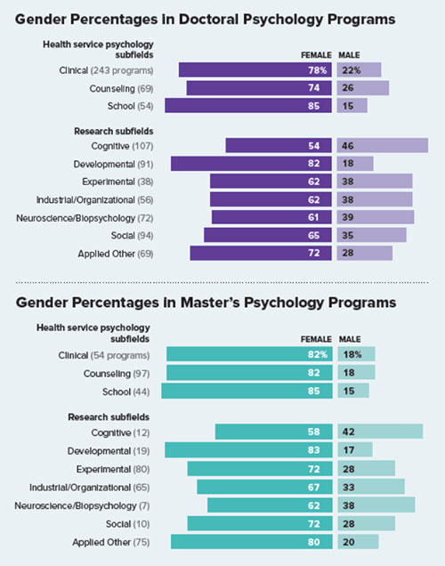
APA (2018)

Slide 29
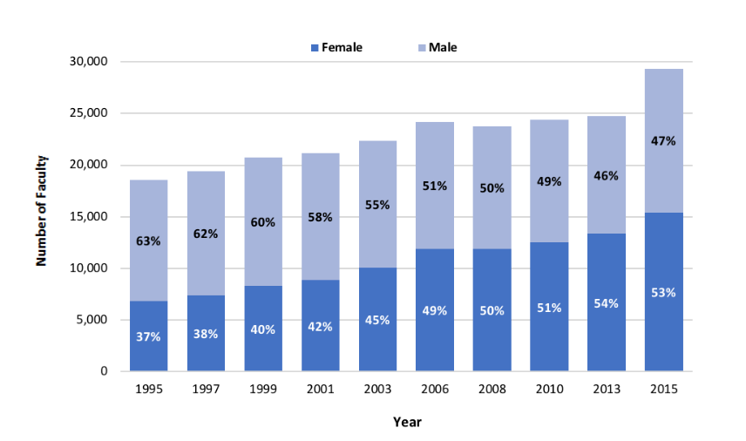
Who gets doctorates in psych?
APA (2019)

Slide 30
Gender Gap in Psychological Research?
Odic & Wojcik (2020):
  Analyzed publication records from 125 high-impact journals
  Found that female psychologists published less and were less cited vs. male counterparts (within same subfields)
    Biggest difference in Neuroscience, Cognitive, and Quantitative (Male dominated)
    Smallest difference in Health and Development (Female dominated)

Slide 31
THE U.S. EQUAL EMPLOYMENT
OPPORTUNITY (EEOC) (2)
Americans with Disabilities Act - Employers cannot discriminate against any individual based on a disability.
Disability – a physical or mental impairment that limits one or more major life activities such as hearing, walking, and breathing.
Has been expanded to include individuals with alcoholism, former drug use, obesity, or psychiatric disabilities.
Bona Fide Occupational Qualification (BFOQ) - Requirement of certain occupations for which denying an individual employment would otherwise violate the law, such as requirements concerning religion or sex.
In some cases, religion, national origin, age, and sex are bona fide occupational qualifications.

Slide 32

JOB SATISFACTION
Results from how we think about our work (cognition) and how we feel about our work (affect).
Influenced by the work itself, our personality, and our culture.
Measured using questionnaires that employees complete.
Can be measured at a global level (general satisfaction with work) or at the level of specific factors (which aspects of the job lead to satisfaction).

Slide 33
JOB SATISFACTION
Factors Involved in Job Satisfaction:
Autonomy – Individual responsibility, control over decisions.
Work Content – Variety, challenge, role clarity. (Most strongly predictive of overall job satisfaction).
Communication – Feedback.
Financial rewards – Salary and benefits. (Weak correlation with job satisfaction).
Growth and development – Personal growth, training, education.
Promotion – Career advancement opportunity.
Coworkers – Professional relations or adequacy.
Supervision and feedback – Support, recognition, fairness.
Workload – Time pressure, tedium.
Work demands – Extra work requirements, insecurity of position.

Slide 34
JOB STRESS
Caused by specific stressors in an occupation.
Leads to poor health, job performance, and family life.
Stressors include:
Having to fill multiple roles.
Workplace role ambiguity.
Lack of career progress.
Lack of job security.
Lack of control over work outcomes.
Isolation.
Work overload.
Discrimination.
Harassment
Bullying.

Slide 35
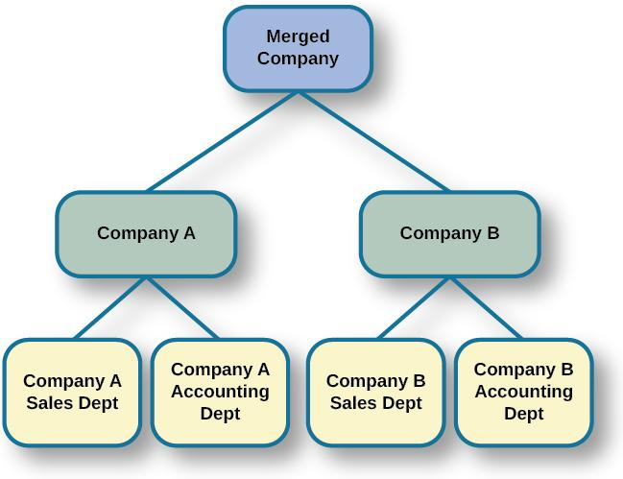
THREATS TO JOB SECURITY
Downsizing – process in which an organization tries to achieve greater overall efficiency by reducing the number of employees.
I-0 psychologists may be involved in how the news is delivered and how laid-off and retained employees are supported.
Notes:
Corporate Mergers - the joining of two organizations.
Acquisition – one organization purchases another.
Often leads to cuts due to duplication of core functions, like sales and accounting, at each company.
Research focuses on understanding employee reactions and practical recommendations for managing organizational changes.

Slide 36
WORK-FAMILY BALANCE (1)
Work-family balance – occurs when people juggle the demands of work life with the demands of family life.
Greenhaus & Beutell (1985):
Three sources of work-family conflicts:
Time devoted to work makes → difficult to fulfill requirements of family, or vice versa.
Strain from participation in work → difficult to fulfill requirements of family, or vice versa.
Specific behaviors required by work → difficult to fulfill requirements of family, or vice versa.

Slide 37
WORK-FAMILY BALANCE (2)
Ways to decrease work-family conflict:
Support in the home – emotional and practical.
  Practical support found to be the most effective.
Workplace support – understanding supervisors, flextime, leave with pay, and telecommuting.
Telecommuting – employees’ ability to set their own hours allowing them to work from home at different parts of the day.
  Telecommuting was found to make the conflict worse.

Slide 38
MANAGEMENT & ORGANIZATIONAL
STRUCTURE
Douglas McGregor (1960)
Combined scientific management and human relations into the notion of leadership behavior.
Scientific management – theory of management that analyzes and synthesized workflows with the main objective of improving economic efficiency, especially labor productivity.
Identified two different styles of managers.
Theory X – manager assumes workers are inherently lazy and unproductive; managers must have control and use punishments.
Theory Y – manager assumes workers are people who seek to work hard and productively; managers and workers can find creative solutions to problems; workers do not need to be controlled and punished.

Slide 39
MANAGEMENT & ORGANIZATIONAL
STRUCTURE
Donald Clifton
Researched how an organization can best use an individual’s strengths.
Argued that our strengths provide the greatest opportunity for growth.
Strength-Based Management – approach that focuses on employees strengths.
Bass (1985)
Transactional leadership – characteristic of leaders who focus on supervision and organizational goals achieved through a system of rewards and punishments; maintenance of the organizational status quo.
Transformational leadership – characteristic of leaders who are 1) charismatic role models, 2) inspirational (optimistic about goal attainment), 3) intellectually stimulating (encourage critical thinking and problem solving), and 4) individually considerate and who seek to change the organization.

Slide 40
Leadership Among Women
Working women and minorities are extremely underrepresented in top leadership positions.
What is now a massive amount of research literature on sex differences in leadership.
  Only difference seems to be that men are more controlling and women are more democratic in their approaches.

Slide 41
GOALS, TEAMWORK & WORK TEAMS (1)
Team-Based Approach:
Many companies structure their organization so that work can be delegated to work teams.
Work team – group of people within an organization or company given a specific task to achieve together.
Brings together diverse skills, experience, and expertise.
Do not always deliver greater productivity.

Slide 42
GOALS, TEAMWORK & WORK TEAMS (2)
Why do some teams work well while others do not?
Social loafing.
Poor communication.
Poor decision-making skills due to conformity effects.
Conflict with the group.
Team halo effect - teams are given credit for their success but individuals within a team are blamed for team failures.

Slide 43
ORGANIZATIONAL CULTURE
Organizational Culture – the values, visions, hierarchies, norms, and interactions among its employees.
How an organization is run, how it operates, and how it makes decisions.
Ostroff, Kinicki & Tamkins (2003)
Three layers in organizational culture:
Observable artifacts – symbols of language (jargon, slang, humor), narratives (stories and legends), and practices (rituals) that represent the underlying cultural assumptions.
Espoused values – concepts/beliefs that management or entire organization endorses.
Basic assumptions – usually unobservable and unquestioned.

Slide 44
VIOLENCE IN THE WORKPLACE (1)
Workplace violence – violence or the threat of violence against workers; can occur inside or outside the workplace.
Includes physical violence, harassment, intimidation, or other disruptive behavior.
Ranges from threats and verbal abuse to physical assaults and homicide.
Warning signs – intimidating behavior, threats, sabotaging equipment, or radical changes in a coworker’s behavior.
Feelings of being treated unfairly, unjustly, or disrespectfully are significant triggers.
  Procedural justice – fairness of the processes by which outcomes are determined in conflicts with or among employees.

Slide 45
VIOLENCE IN THE WORKPLACE (2)
Greenberg & Barling (1999):
History of aggression and amount of alcohol consumed → accurate predictors of violence against a coworker.
Feelings of being unfairly treated or untrusted → predictors of aggression against a supervisor.
Job security and alcohol consumption → predictors of aggression against a subordinate.

Slide 46
Employee Motivation
Vroom’s expectancy theory—Workers become motivated and exert effort when they believe:
  Their effort will result in an improved performance
  Their performance will be recognized and rewarded
  The monetary and symbolic rewards that are offered are valuable and desirable.
The key, they maintain, is for people to set specific and difficult goals for themselves or others.

Slide 47
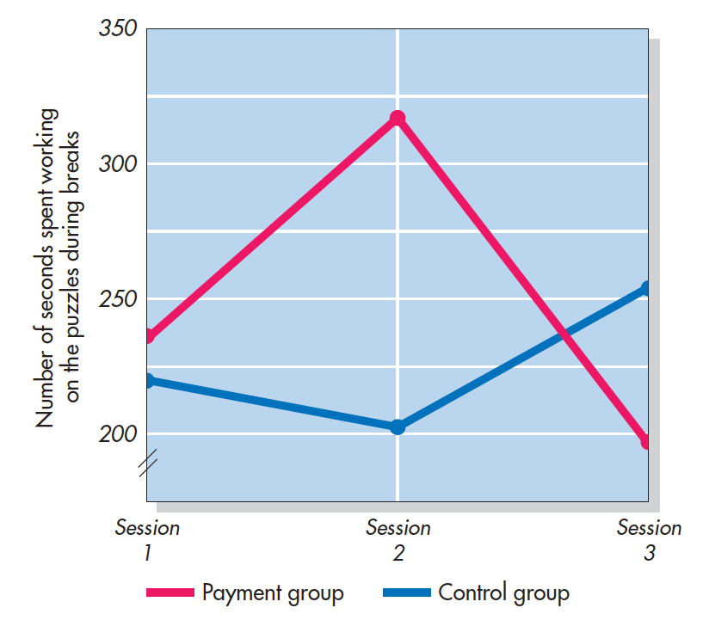
The Effect of Payment on Intrinsic Motivation (Deci 1971)
Participants completed puzzles in three different sessions (time spent was dv)
Session 1: No one was paid
Session 2: Half were paid
Session 3: Money was taken away. How did motivation change?
Notes:
Figure 13.6 The Effect of Payment on Intrinsic Motivation: Turning Play Into Work In this study, participants worked three times on puzzles they found interesting. After each session, the amount of free time participants spent on the puzzles served as a record of their intrinsic motivation. During the second session, half of the participants were paid for puzzles they completed and half were not. Those paid in the second session later showed less interest in the puzzles when the money was no longer available. Deci (1971).

